Slide 1
Classification and Regression Trees (CART) Algorithm
Sri Harsha A

Slide 2
Classification and Regression Trees
Classification and Regression Trees (CART) is only a modern term for what are otherwise known as Decision Trees.
Decision Trees have been around for a very long time and are important for predictive modelling in Machine Learning.
As the name suggests, these trees are used for classification and prediction problems.
This serve the basis for other modern classifiers such as Random Forest

Slide 3
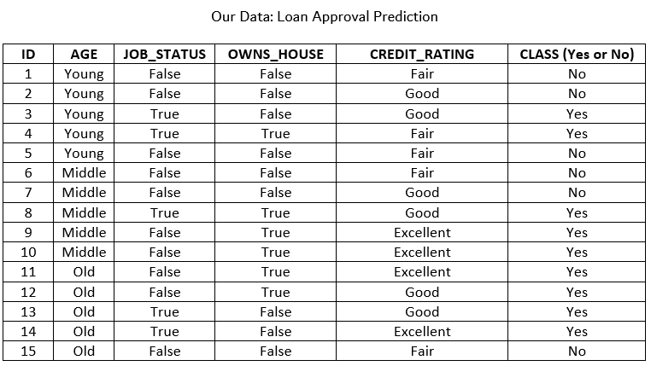
Classification
Generally, a classification problem can be described as follows: Data: A set of records (instances) that are described by: * k attributes: A1, A2,...Ak * A class: Discrete set of labels Goal: To learn a classification model from the data that can be used to predict the classes of new (future, or test) instances.

Slide 4
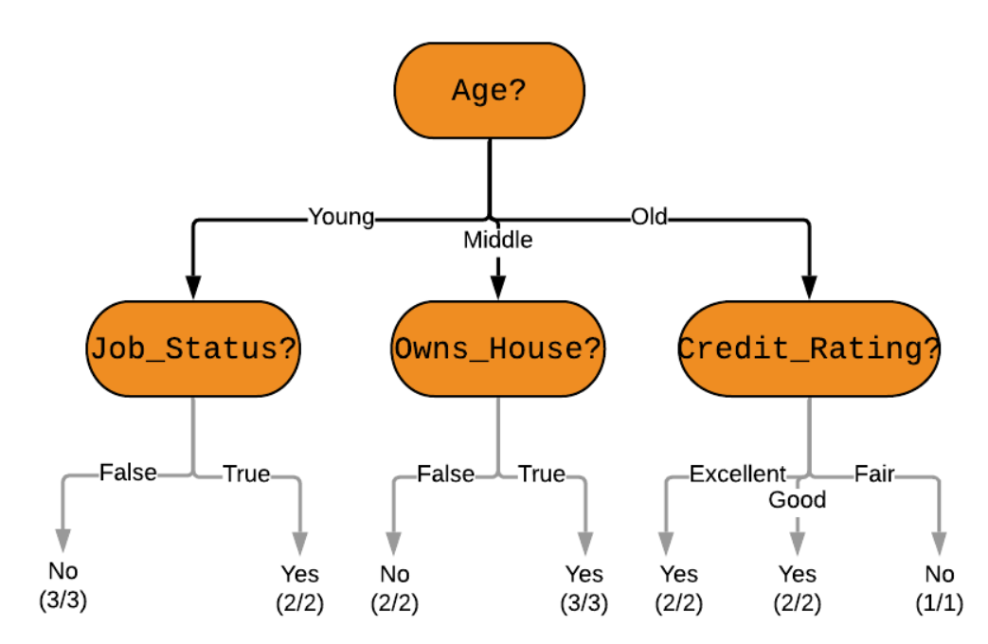
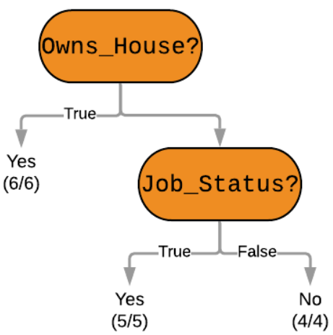
Classification
However, we must note that there can be many other possible decision trees for a given problem - we want the shortest one.
Want it to be better in terms of accuracy (prediction error measured in terms of misclassification cost).

Slide 5
CART Algorithm for Classification
The tree will be constructed in a top-down approach as follows:
Step 1: Start at the root node with all training instances
Step 2: Select an attribute on the basis of splitting criteria (Gain Ratio or other impurity metrics)
Step 3: Partition instances according to selected attribute recursively
Partitioning stops when:
There are no examples left
All examples for a given node belong to the same class
There are no remaining attributes for further partitioning – majority class is the leaf

Slide 6
What is Impurity?
In our dataset we can see that a loan is always approved when the applicant owns their own house. This is very informative (and certain) and is hence set as the root node of the alternative decision tree shown previously.
Classifying a lot of future applicants will be easy. Selecting the age attribute is not as informative - there is a degree of uncertainity (or impurity). The person's age does not seem to affect the final class as much.
Based on the above discussion:
A subset of data is pure if all instances belong to the same class.
Our objective is to reduce impurity or uncertainty in data as much as possible.
The metric (or heuristic) used in CART to measure impurity is the Gini Index and we select the attributes with lower Gini Indices first.

Slide 7
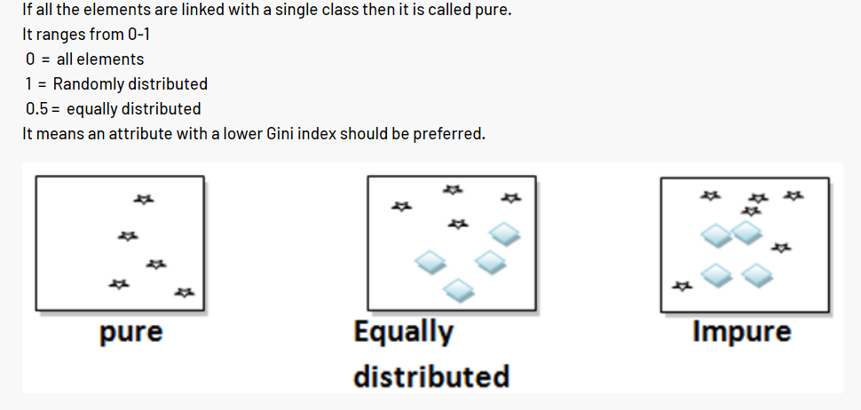
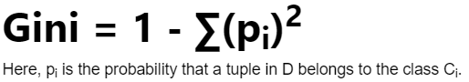
Gini Index
Gini index or Gini impurity measures the degree or probability of a particular variable being wrongly classified when it is randomly chosen.
But what is actually meant by ‘impurity’? If all the elements belong to a single class, then it can be called pure.
The degree of Gini index varies between 0 and 1, where 0 denotes that all elements belong to a certain class or if there exists only one class, and 1 denotes that the elements are randomly distributed across various classes.
A Gini Index of 0.5 denotes equally distributed elements into some classes.

Slide 8
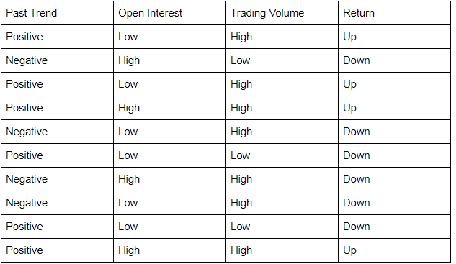
Example of Gini Index

Slide 9
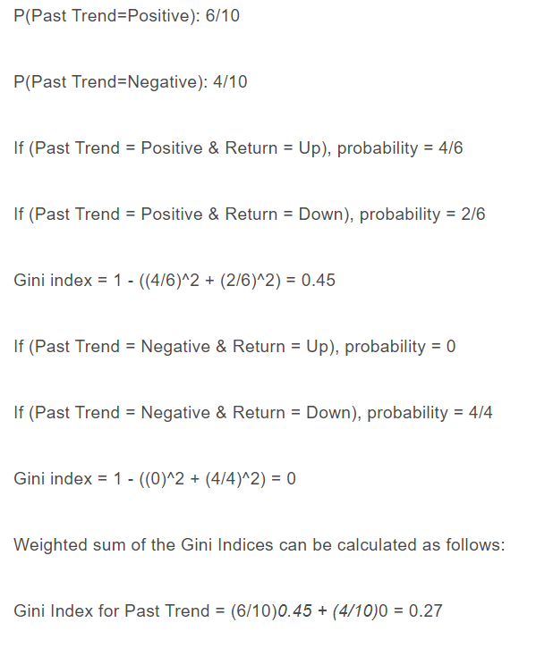
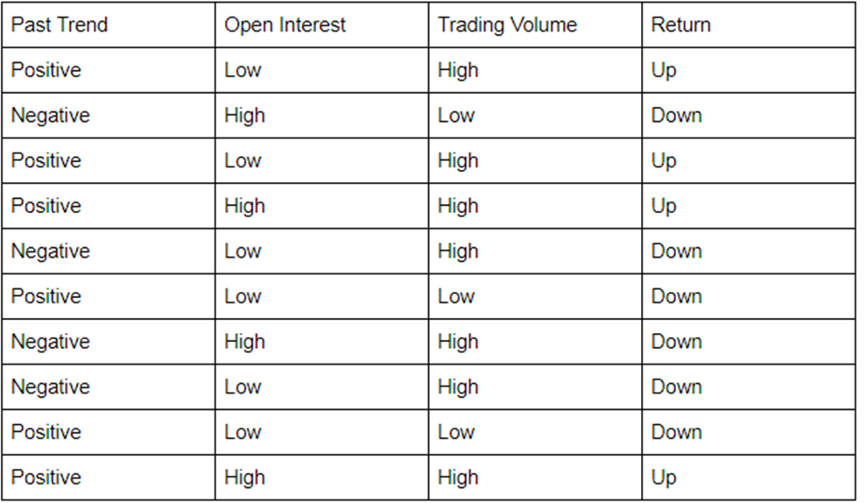
Let’s start by calculating the Gini Index for ‘Past Trend’.

Slide 10
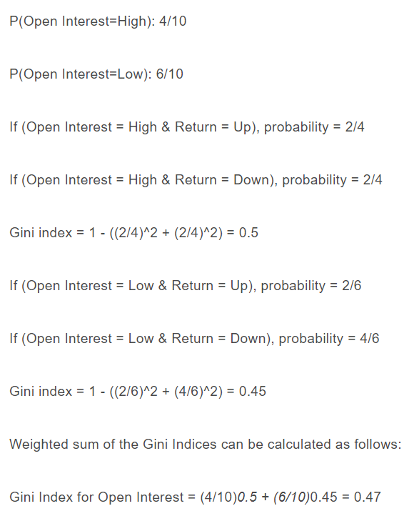
Calculation of Gini Index for Open Interest

Slide 11
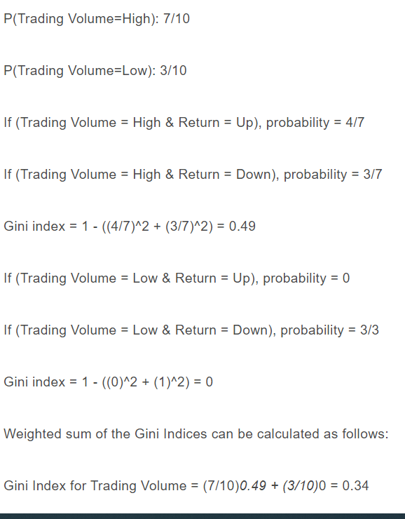
Trading Volume

Slide 12
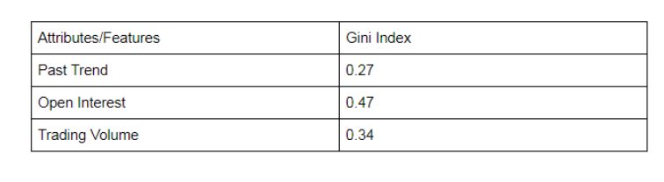
Example
From the above table, we observe that ‘Past Trend’ has the lowest Gini Index and hence it will be chosen as the root node for how decision tree works.
We will repeat the same procedure to determine the sub-nodes or branches of the decision tree.

Slide 13
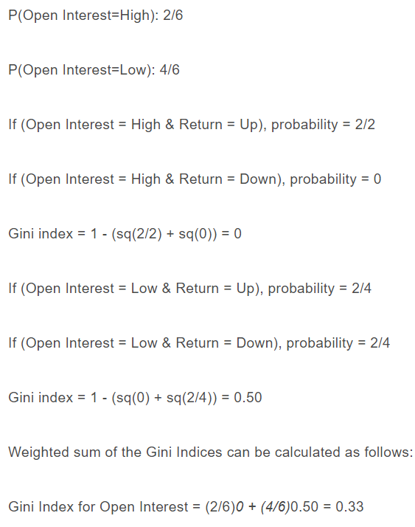
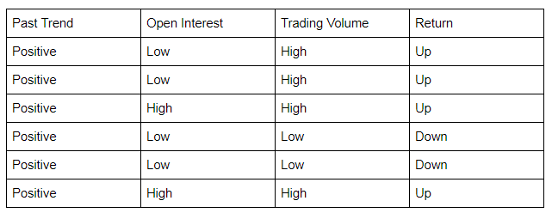
Gini Index for the ‘Positive’ branch
Calculation of Gini Index of Open Interest for Positive Past Trend

Slide 14
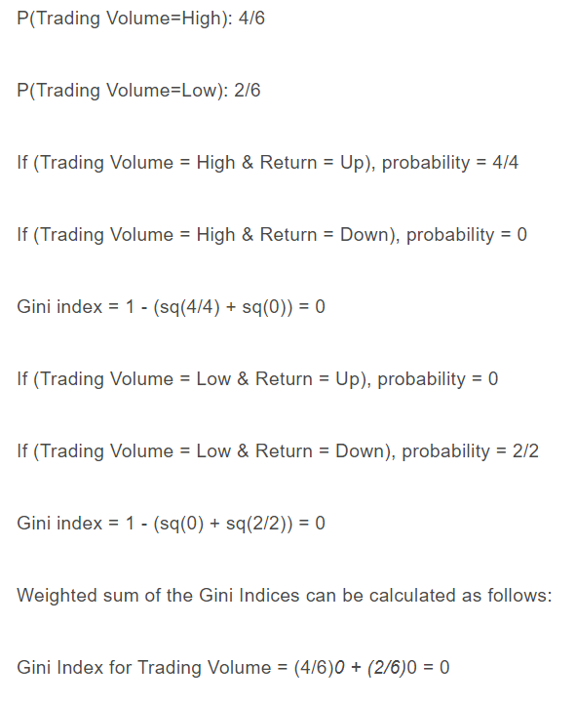
Gini Index for the ‘Positive’ branch
Calculation of Gini Index of Open Interest for Trading Volume

Slide 15
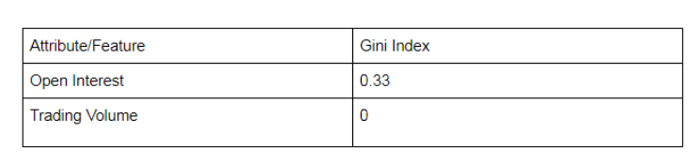
Gini Index for the ‘Positive’ branch
We will split the node further using the ‘Trading Volume’ feature, as it has the minimum Gini index.
Gini Index, unlike information gain, isn’t computationally intensive as it doesn’t involve the logarithm function used to calculate entropy in information gain, which is why Gini Index is preferred over Information gain

Slide 16
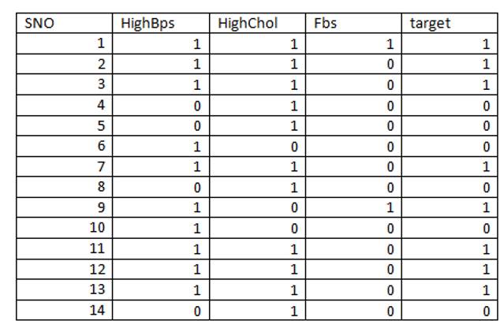
Practice Problem – Using Gini Index
Refer : https://www.numpyninja.com/post/understanding-the-gini-index-in-decision-tree-with-an-example

Slide 17
References
https://blog.quantinsti.com/gini-index/
https://medium.datadriveninvestor.com/decision-tree-algorithm-with-hands-on-example-e6c2afb40d38
https://www.numpyninja.com/post/understanding-the-gini-index-in-decision-tree-with-an-example

